Slide 1
Introduction to Family Medicine
GP Tutor Meeting
11th September 2024
Dr Gráinne Kearney

Slide 2


Slide 3
Agenda
General updates
Year 1 – Family Attachment
Year 2 – General Practice Experience
Tutor group work – reflecting on learning events and tutor feedback

Slide 4
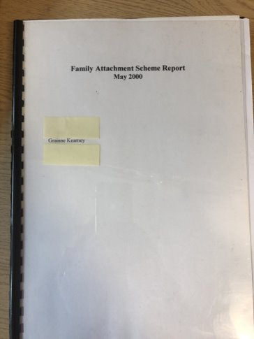
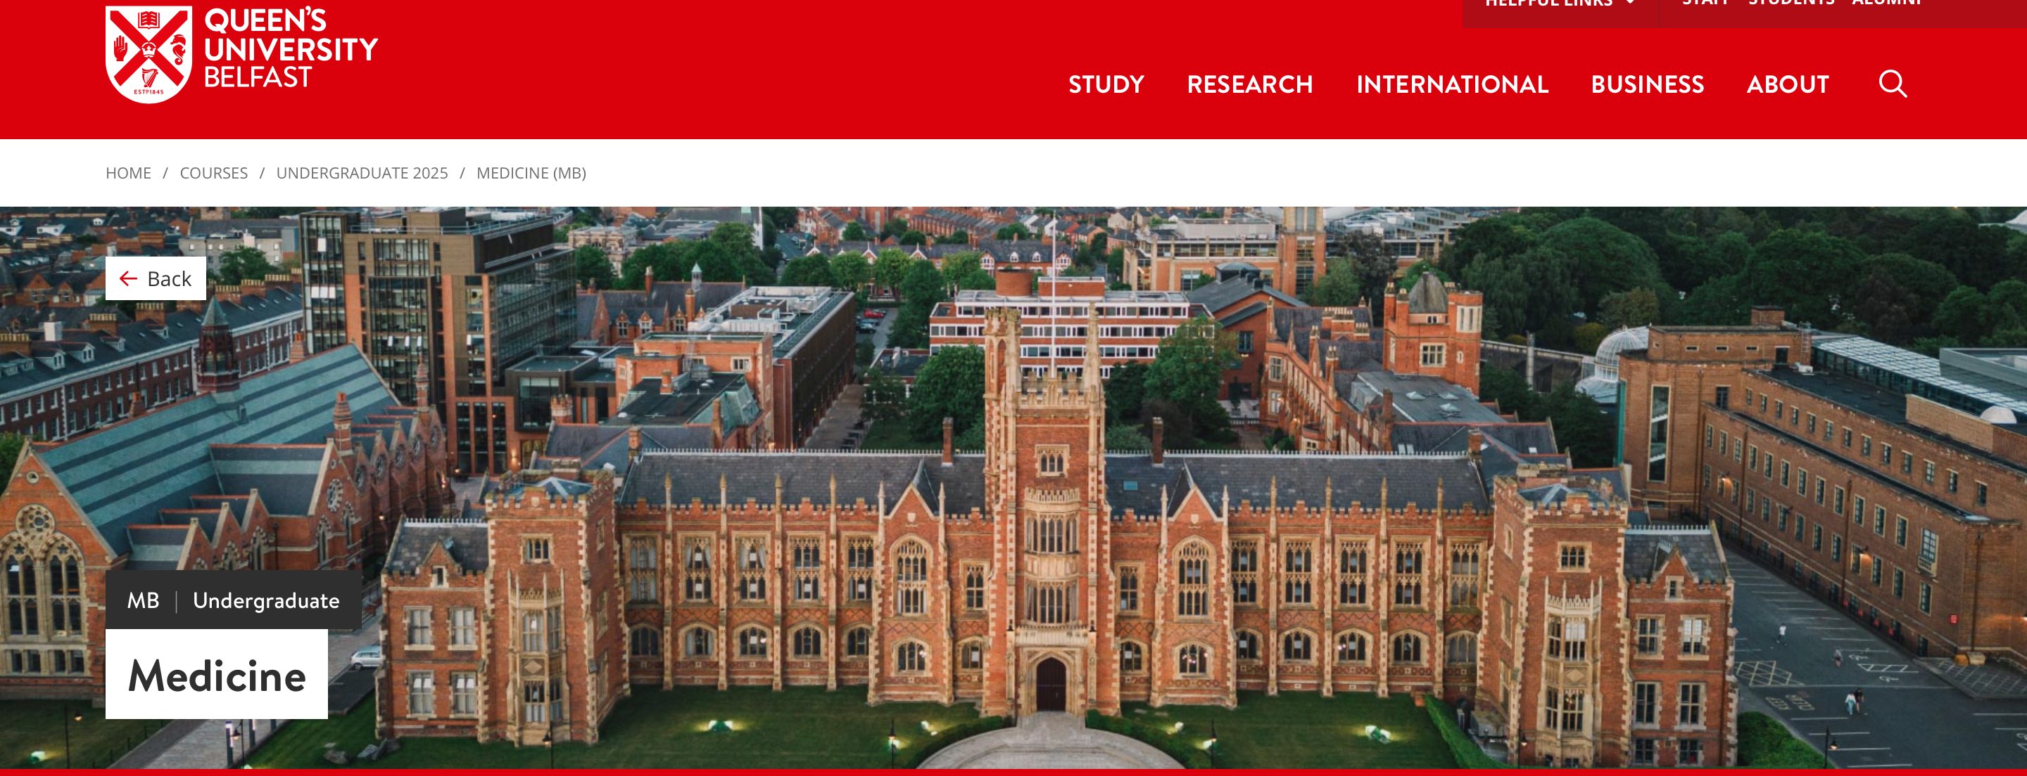
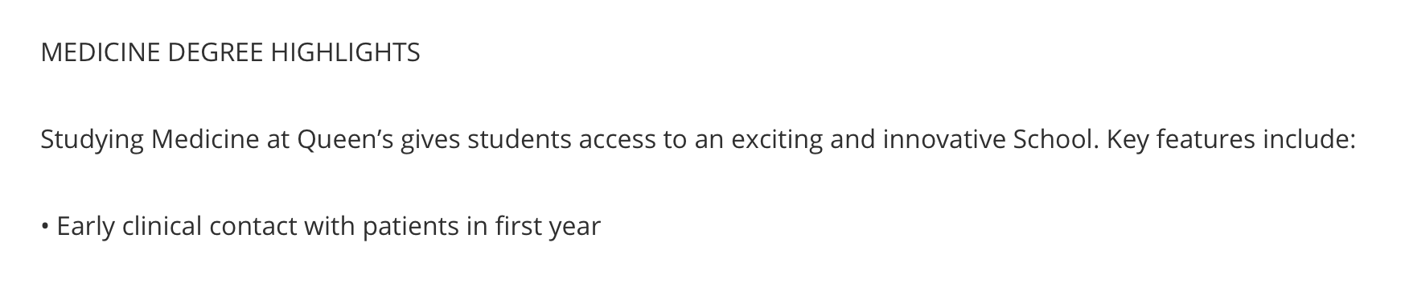

Slide 5

General Practice across the QUB Medical School Curriculum 2024/2025
Year 1
Year 2
Year 3
Year 4
Year 5
FAMILY MEDICINE
Family Attachment
5 PM sessions inc. home visits
FAMILY MEDICINE
General Practice Experience
5 PM sessions
GENERAL PRACTICE
ATTACHMENT
12 AM sessions in practice,
GENERAL PRACTICE
LONGITUDINAL CLERKSHIP
4 x 2 weeks
PREPARATION FOR PRACTICE (primary and preventative medicine)
7 weeks

Slide 6
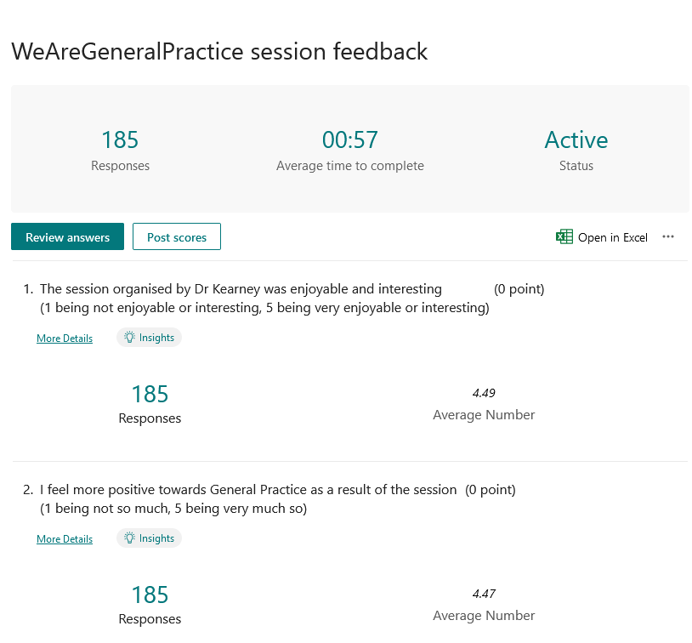

Slide 7
When asked something they enjoyed in the session
“Hearing the passion all the speakers had for general practice, reaffirming my aspirations to become a GP”
“I loved the stories from GP and experiences (remarkable in some cases). I came out of this talk so excited for my future!!!!”

Slide 8

In the “Teaching General Practice” framework, Family Medicine is a natural home to realise the following aspiration,
“We strongly recommend students being encouraged to consult with patients one-to-one from an early stage in training.”

Slide 9
Family Medicine
Year 1 – Care for the person and care within families
Year 2 – Care within the GP Practice and care within communities

Slide 10
Agenda
General updates
Year 1 – Family Attachment
Year 2 – General Practice Experience
Tutor group work - reflecting on learning events and tutor feedback

Slide 11
General Housekeeping
Dates
Feedback
Tutor resources
Student attendance and support
Home visit guidance
Pearse Donnelly prize
Progress Test/MLA
Involvement of senior students/trainees

Slide 12
Year 1 dates
​ | Y1 TUESDAY ​ | Y1 THURSDAY ​
Session 1 ​ | 1 Oct ​ ​ | 3 Oct ​ ​
Session 2 ​ | 5 Nov ​ ​ | 7 Nov ​ ​
Session 3 ​ | 19 Nov ​ ​ | 21 Nov ​ ​
Session 4 ​ | 21 Jan ​ ​ | 23 Jan ​ ​
Session 5 ​ | 4 Mar ​ ​ | 13 Mar ​ ​

Slide 13
Year 2 dates
​ | Y2 TUESDAY ​ | Y2 THURSDAY ​
Session 1 ​ | 17/24 Sept ​ ​ | 19/26 Sept​ ​
Session 2 ​ | 8/22 Oct ​ ​ | 17/31 Oct ​ ​
Session 3 ​ | 26 Nov/10 Dec​ ​ | 28Nov/ 5 Dec​ ​
Session 4 ​ | 4 Mar ​ ​ | 11 Mar ​
Session 5 ​ | 1 April ​ ​ | 3 April​ ​

Slide 14
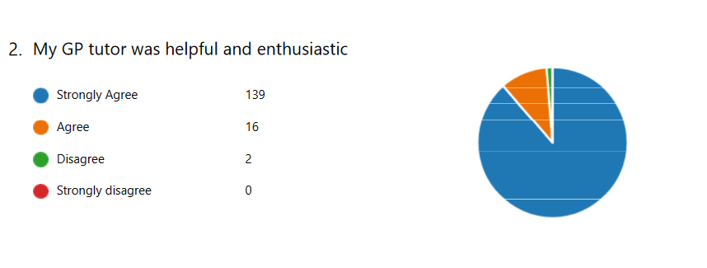
Student feedback Y1

Slide 15
Student feedback for Y1
“Having the opportunity to meet with a patient has been a huge privilege, and a highlight of my time in First Year. Going into the visits, I was met with excitement for the prospect of meeting our first ‘real’ patient, with apprehension being among the predominant feelings. However, by the end of our time, I was overwhelmed with the value of meeting a patient in their home, allowing me to immerse myself, at least partly, in some of the socioeconomic and lifestyle factors that impacted our patient’s health. I thoroughly enjoyed meeting with our patient, who shared countless stories from
her lifetime, all of which were extremely insightful into the experiences which can shape a patient’s perception of
health. It has helped me be more conscious that a
patient is more than their illness; they have a multitude of concerns and a breadth of socioeconomic influences.”

Slide 16
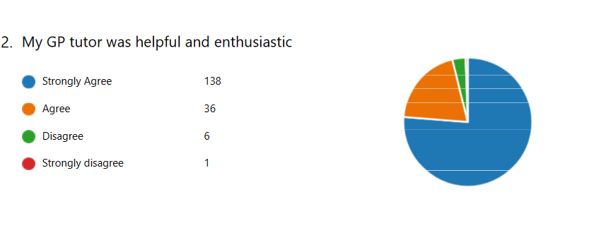
Student feedback Y2

Slide 17
Student feedback Y2
It was great receiving an insight into primary health care, and gaining an appreciation for the vast amount of work expected of a GP.
Visiting the GP practice and getting to see how it runs day to day. Also being able to see patients, take histories from them and do examinations. This was the first time we got to see real patients, it was a very valuable session.

Slide 18
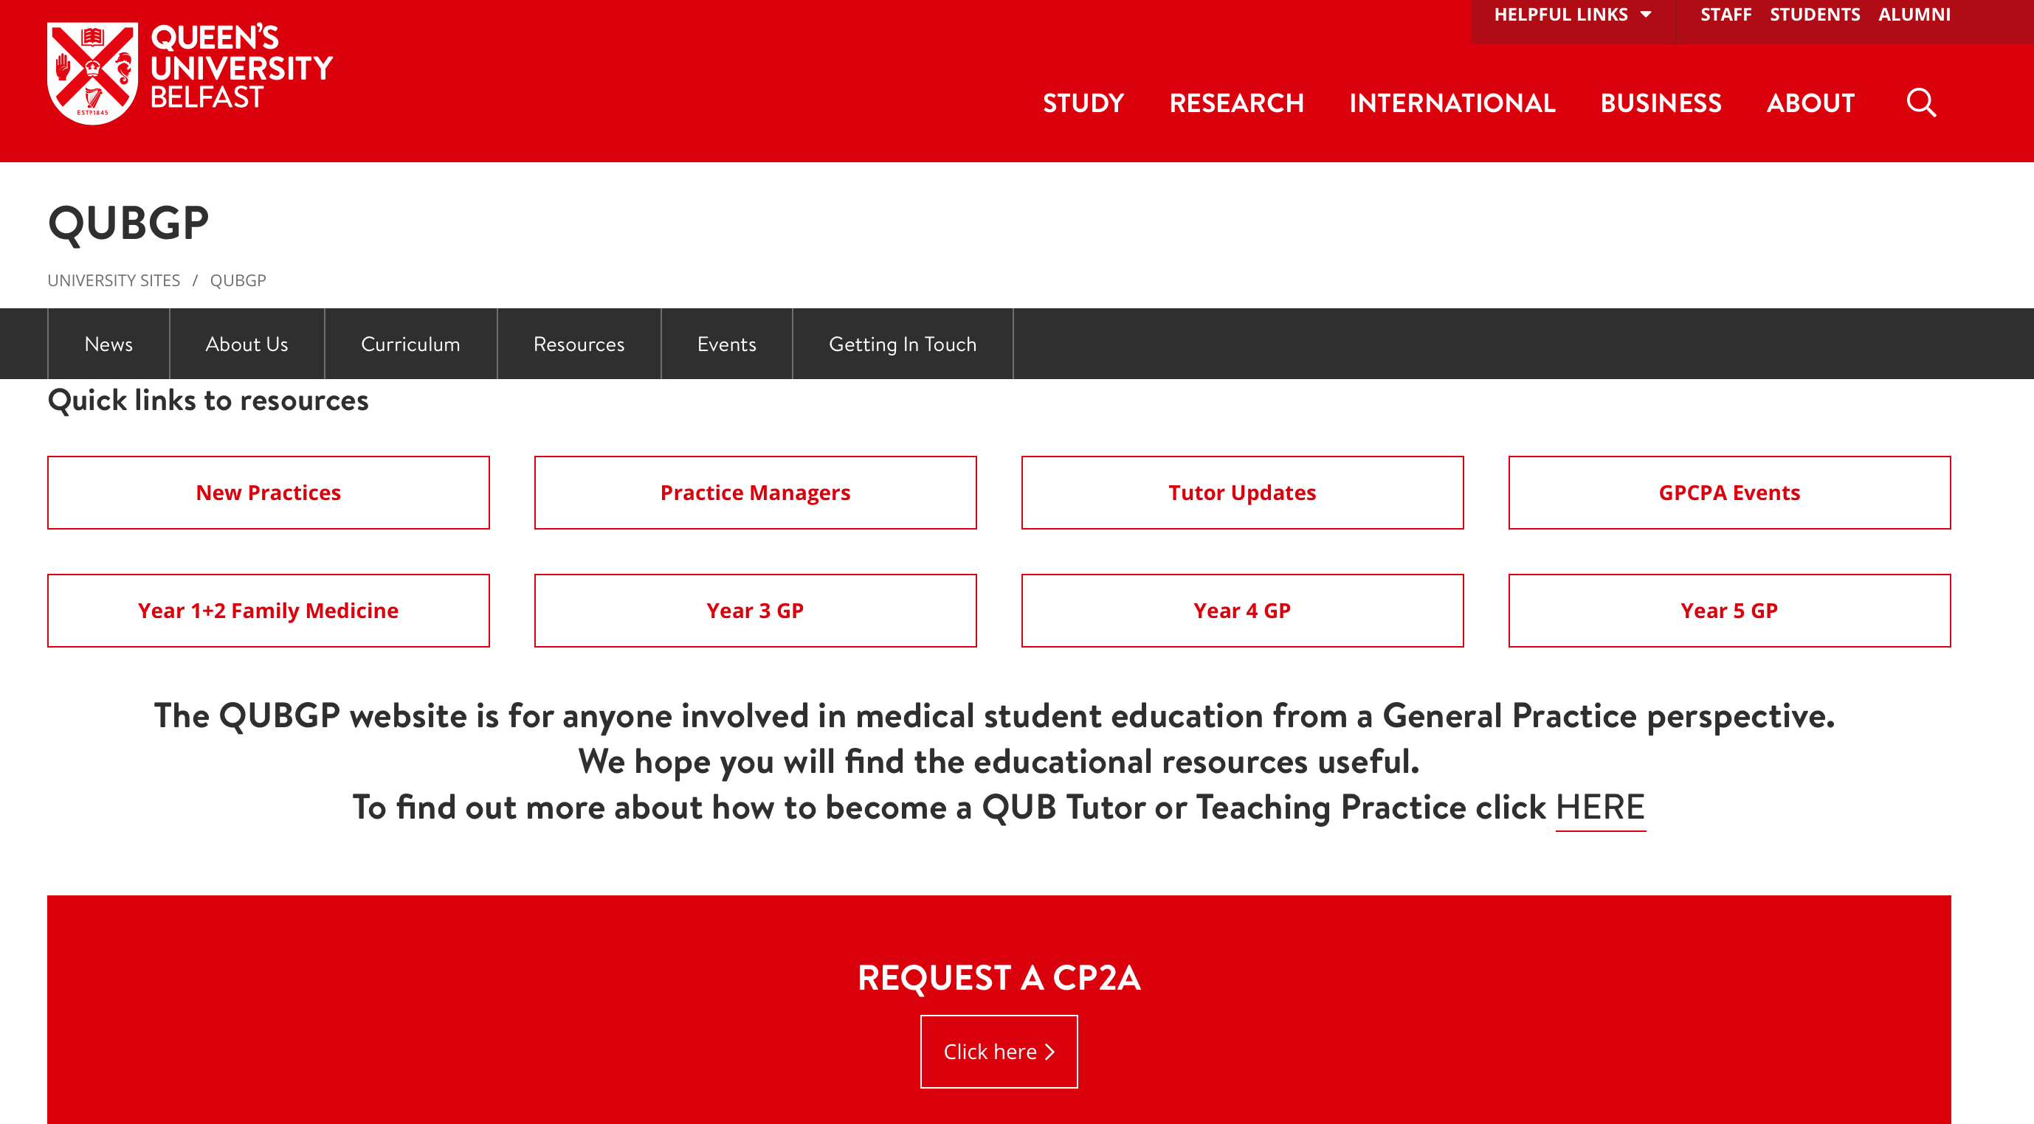
https://www.med.qub.ac.uk/wp-gp/
Notes:
Password – COVID19

Slide 19
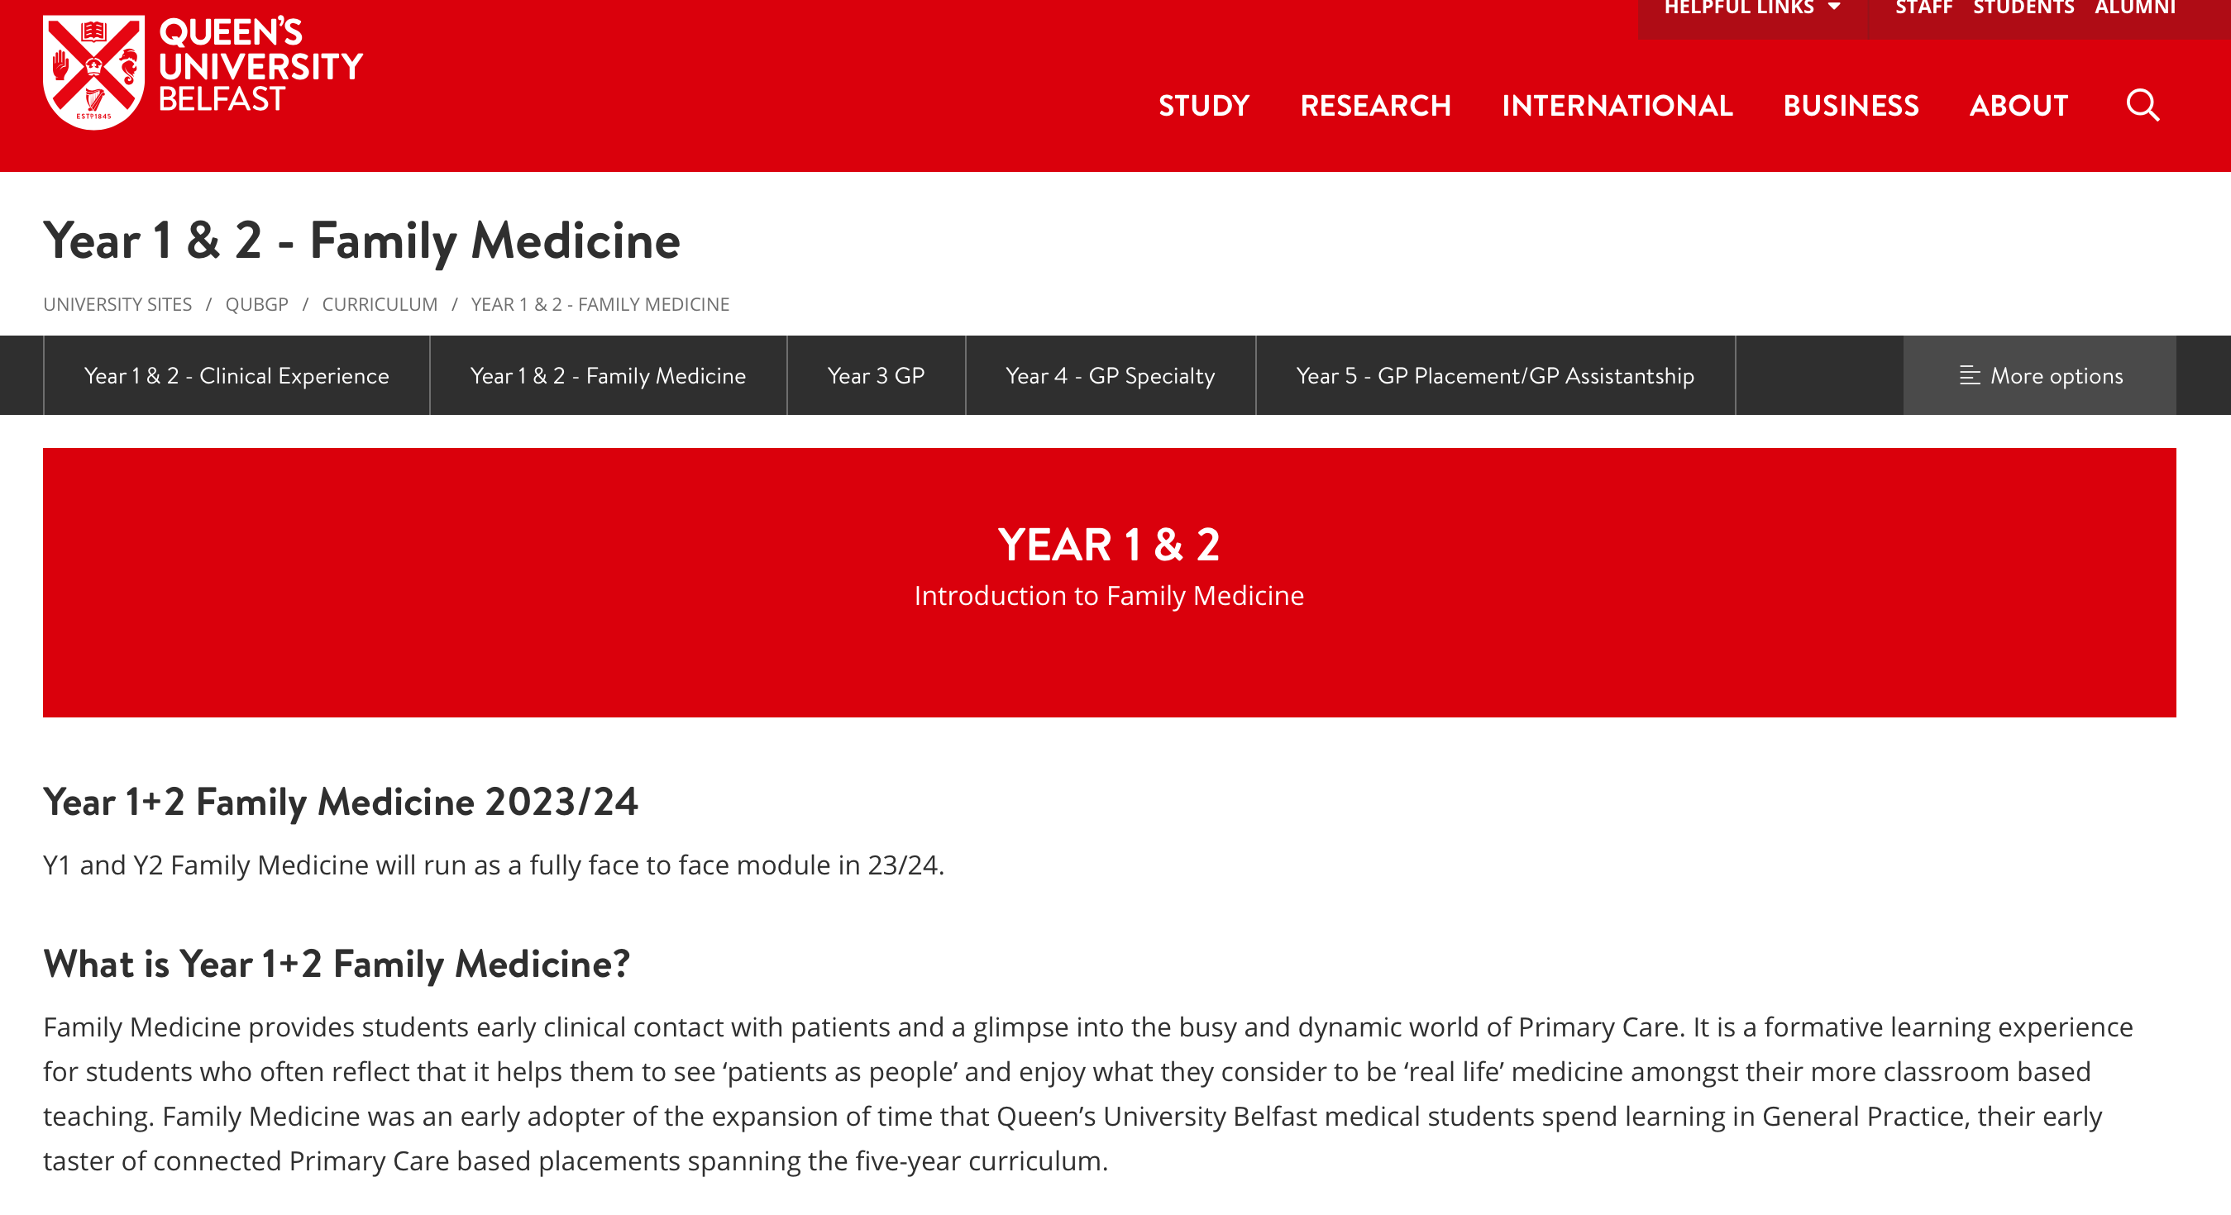

Slide 20
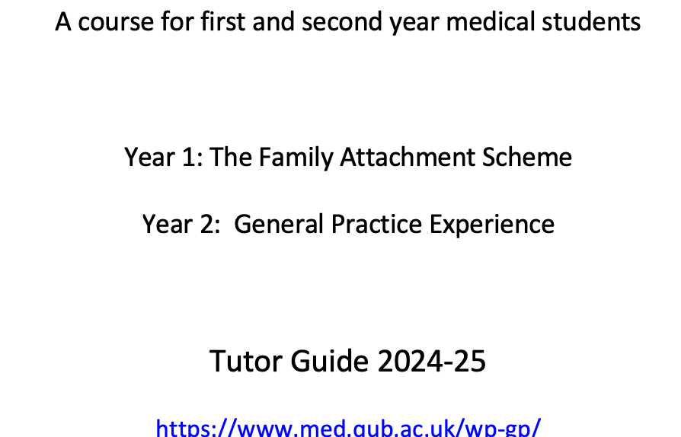
Tutor resources -Tutor’s Guide
Introduction to Family Medicine
A course for first and second year medical students
Year 1: The Family Attachment Scheme
Year 2: General Practice Experience
Tutor Guide 2022-223

Slide 21
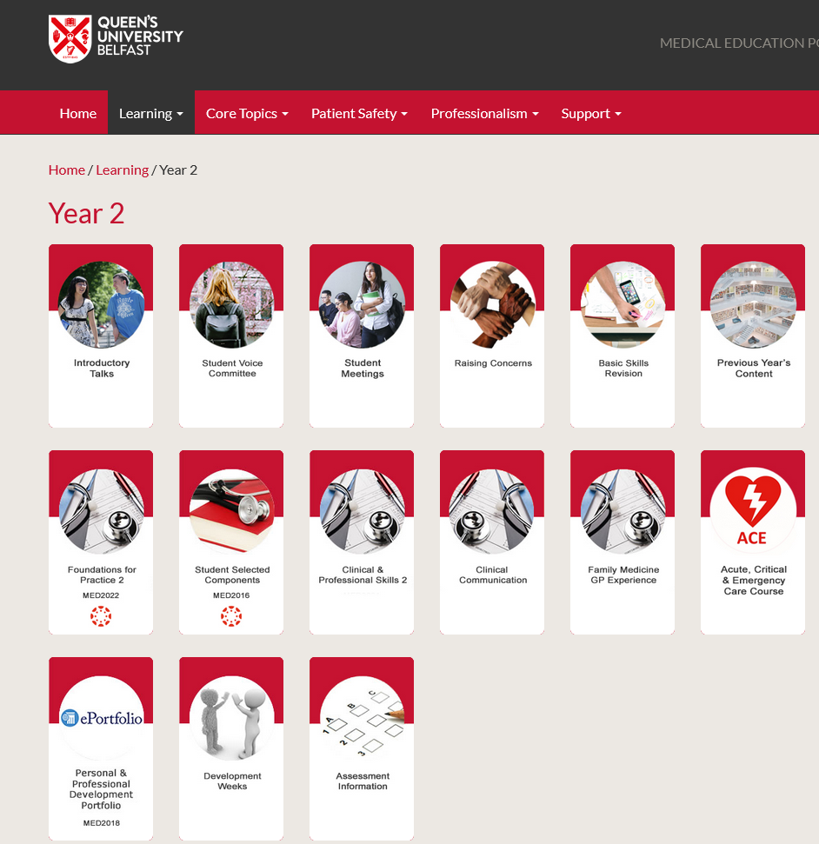
Portal

Slide 22
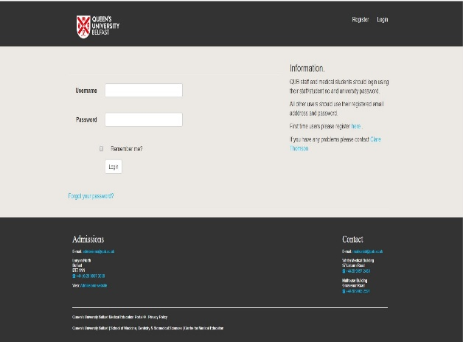
Access to the Portal

Slide 23
Student attendance
100% expected – if not let us know
Repeating student also 100% (do not have to repeat assessments)
Attendance is often a marker of a student who may need support or have issues with professionalism

Slide 24
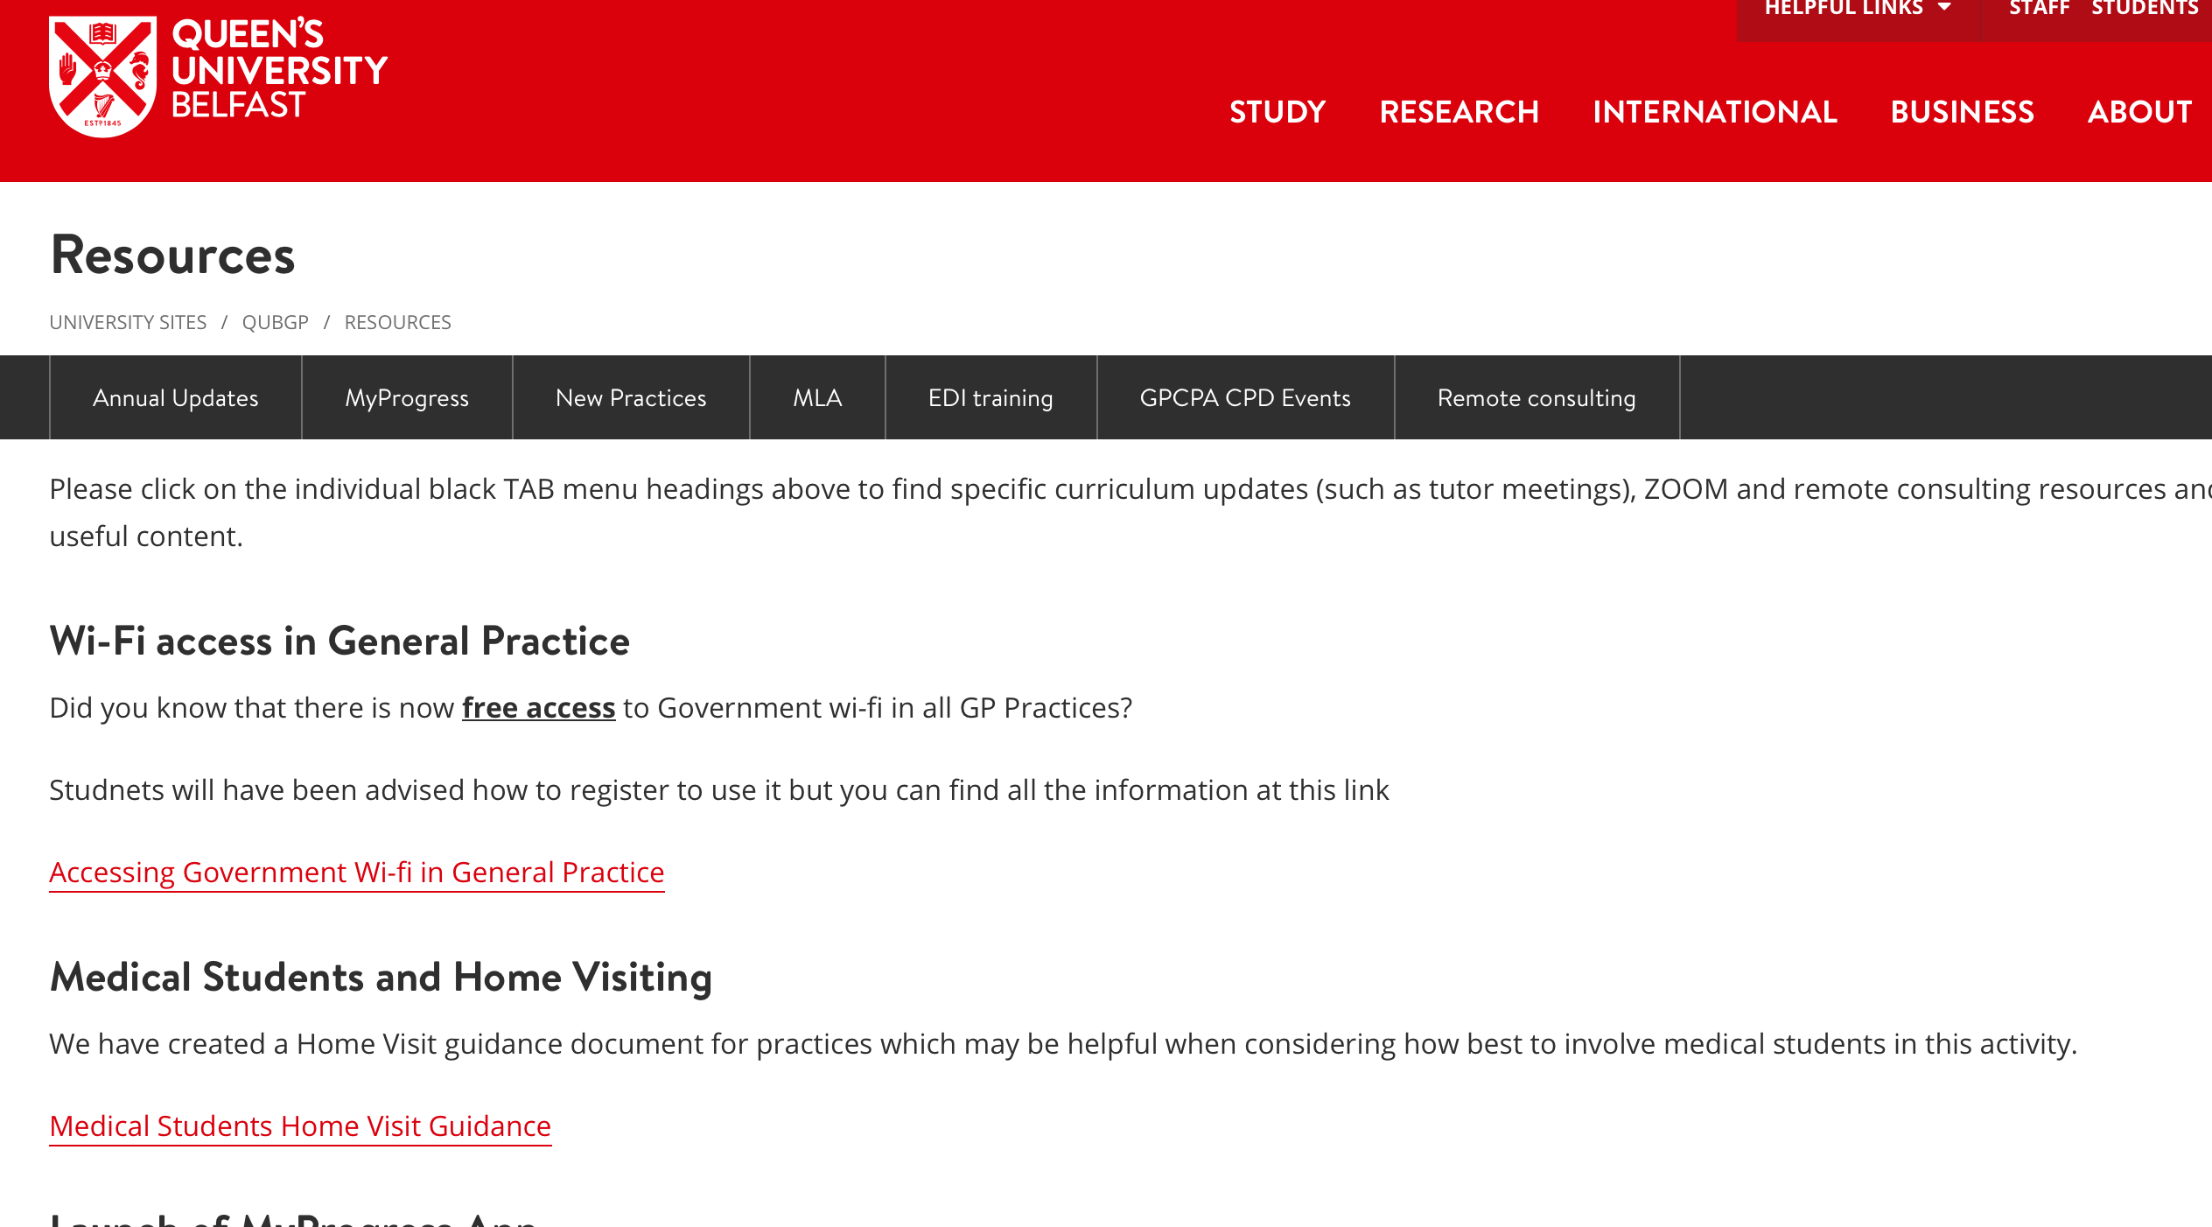

Slide 25
Home visit guide
BEFORE Home Visit
Ensure you have patient contact information (address including post code and phone number)
Confirm with GP the time you are expected to arrive at the home and time you should be back at the practice, if expected back.
Check if you need any patient summary notes provided by the GP.
Have a mobile telephone with a contact number for the practice.

Slide 26
AT Home Visit
Ensure on entering the house you are speaking to the correct person, confirm with name and date of birth and ensure that they are expecting you.
'A picture paints a thousand words.' Look around to see what you can learn about the patient and their condition from their home life.
Consider falls risks, sensory impairment, ability to manage ADLs
  Are there stairs/handrail?
  Are there home modifications?
Consider medication and who administers/orders meds.
Consider state of home
  Is it an area of deprivation or affluence?
  is it warmer or colder than expected?
  Is it tidy/organised/disorganised?
  Is it in disrepair or good condition?
  does the patient cook or how are nutritional needs met?
Make a note of any other relatives or carers who are also at home. If alone, who is their emergency support person?

Slide 27
AFTER home visit
Debrief with GP tutor – use reflective home visits template.
Ensure all documentation relating to the visit is shredded at the practice.

Slide 28
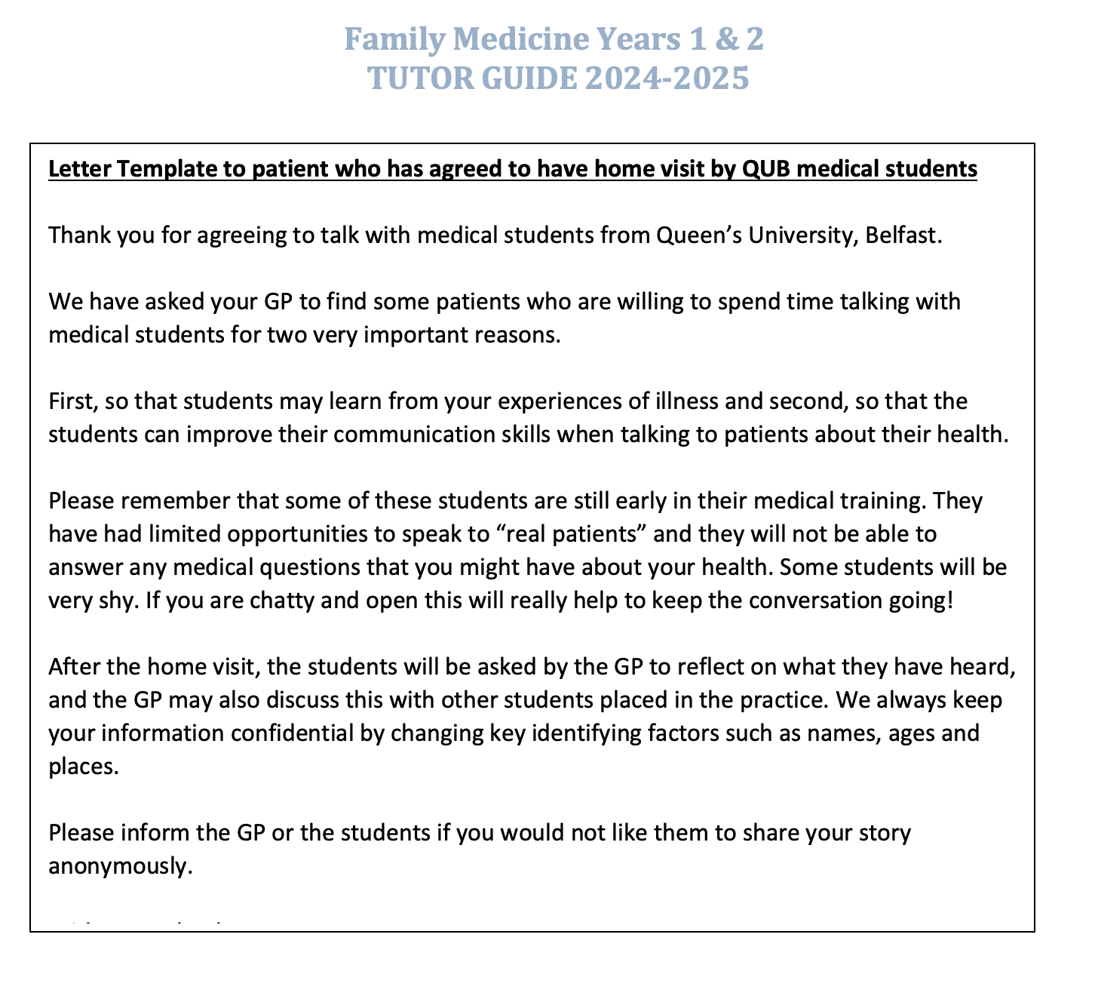

Slide 29
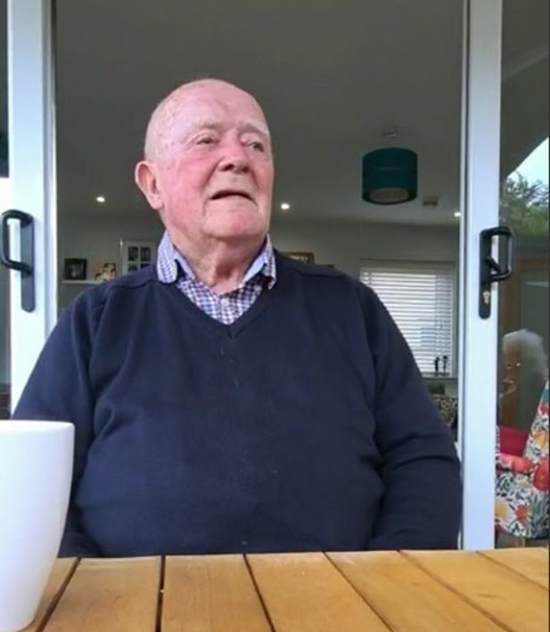
Pearse Donnelly Prize Winners 2223

Slide 30
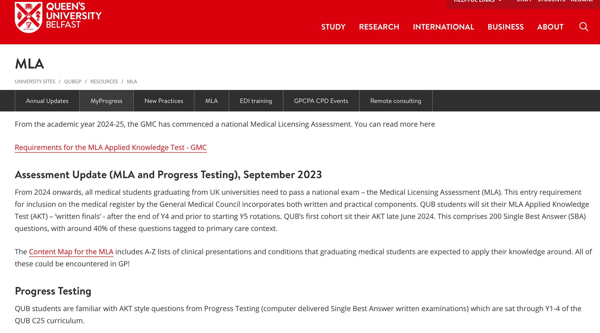
Progress Test and MLA

Slide 31

Consider involvement of senior students/trainees

Slide 32
Agenda
General updates
Year 1 – Family Attachment
Year 2 – General Practice Experience
Tutor group work - reflecting on learning events and tutor feedback

Slide 33
Year 1 – Family Attachment 24/25
Continues face to face both in practice and with patients
Runs same as 23/24
Reports due 3/4/25
Assessment remains the same – joint report and reflective blog – students submit only to GP tutors
?Possibility of patients reading reports in the future
No more ‘Duties of a Doctor’ …

Slide 34
Tutorials
Session 1- Introduction to the Family Attachment Scheme
Session 2 – Contact with the families
Session 3- Review of the first contact, planning next contact and the basics of clinical communications
Session 4 – Special presentations, introduction to medical notes and starting to put together the report
Session 5 – Creating your Family Attachment report and blog
Could consider doing sessions 3 and 5 remotely …

Slide 35
Choosing patients/families
Patient/family who are happy to welcome students into their home
Happy to be contacted independent of you
Ideally available on date of second tutorial for introduction (then 2+ times to be agreed with the students)
Not chosen due to their “disease”
(Reminder re guidance on website)

Slide 36
Cultural humility
Become ‘the student of the patient’
Tutorial 1 - introduction
Tutorial 5 – reflection (for their blog)
Notes:
CH – make clear to tutors and students that their GP tutor is not there to teach them CH, just facilitate – more resources - tutor feedback
Reminder CH
early development of a mindset whereby students have awareness of their own culture in the broadest sense before they start to consider patient’s culture. The idea is to help them become active and attentive learners and adopt the stance of becoming the student of the patient. Lines up well with the ethos of Family Attachment and they will have the opportunity to reflect on this in their individual blog, as part of their report
I will have addressed cultural humility with the students in their introductory letter. Have created a video for them and how it relates to the Family Attachment scheme. The link to this video and other relevant links will be placed on the portal and tutor website in case you are keen to learn a little more about it.
You are not there to teach them about this
It is not intended that much of this important first tutorial is spent on this. Indeed, the concept is likely to be difficult to grasp and you can reassure the students of this.
However, as the students spend the next few months learning from their patient and finding this a valuable experience, they should feel ready to discuss this in the final tutorial and in preparation for their personal blogs.
Whilst the title cultural humility might be new to you, as it was to me, I hope you will recognise it as aligning with the ethos of Family Attachment and indeed much of the students’ learning around it will be from how you model it in how you talk about your interactions and experiences with patients.
The below table of the 5Rs of cultural humility is what will suggest they use to reflect on it in their blogs. You can use it here in session 1 if you want. You will be using it in session 5 when they are planning their blogs.

Slide 37
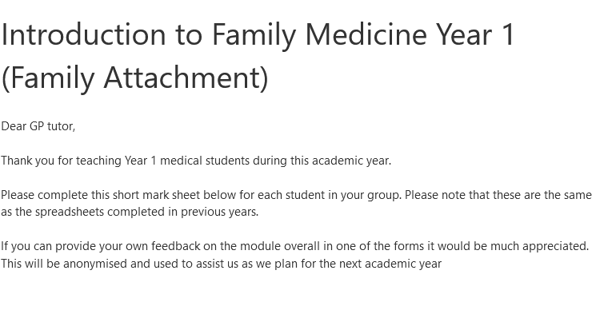
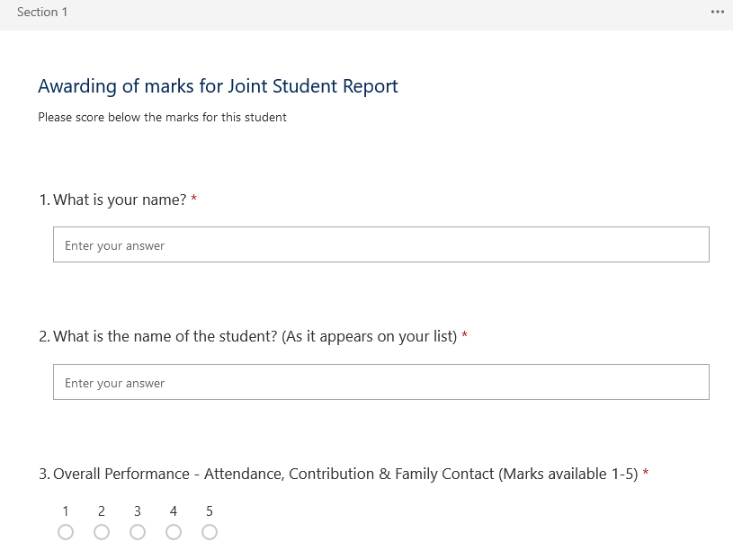
Assessment

Slide 38
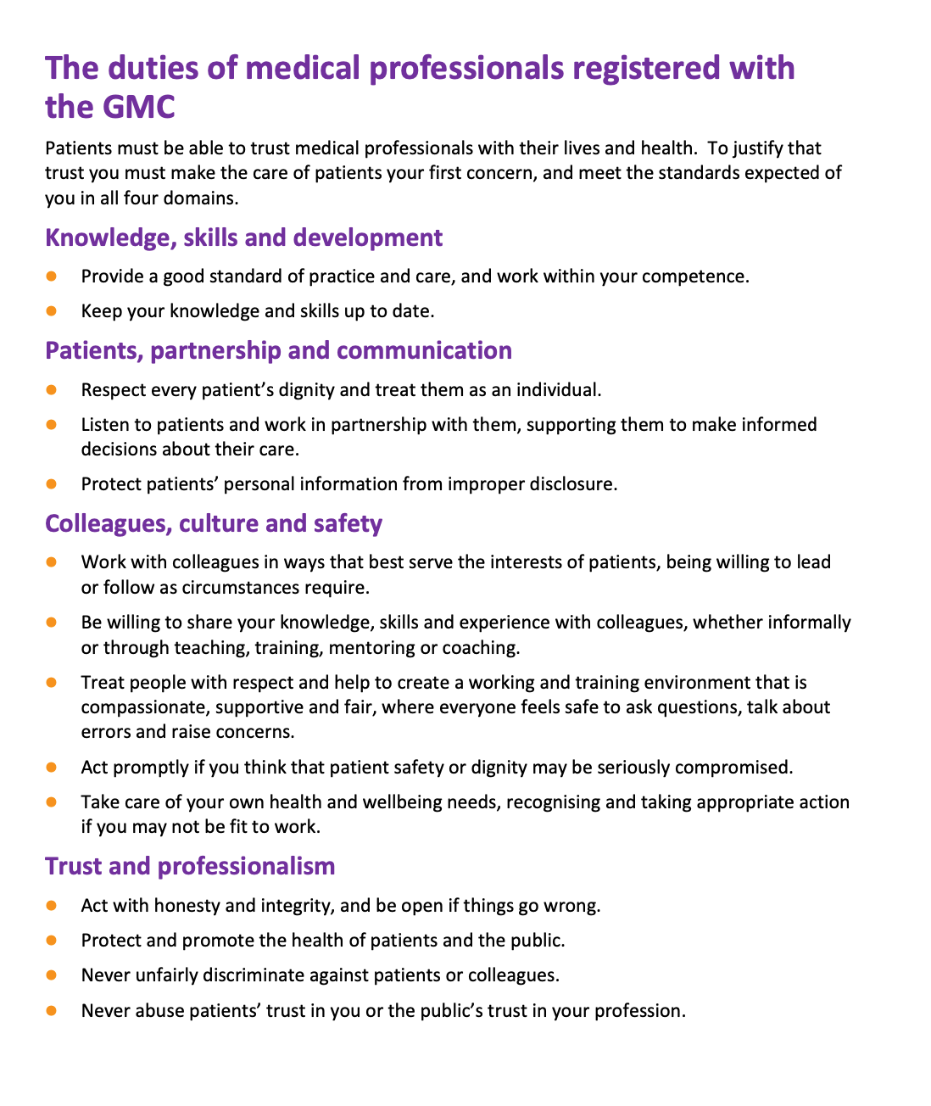

Slide 39
Summary of what’s new for Year 1
Little change from 23/24
Change in report submission for students and understanding of changing access to information

Slide 40
Agenda
General updates
Year 1 – Family Attachment
Year 2 – General Practice Experience
Tutor group work - reflecting on learning events and tutor feedback

Slide 41
Year 2 – General Practice Experience 24/25
Main emphasis is patient contact
The students just love meeting patients face-to-face. The patients love meeting them too. it's great to hear the students reflecting on their experiences.

Slide 42
Year 2 – General Practice Experience 24/25
Session 1 – Introduction
Session 2-4 - Practice-based activities
Session 5 – Assessment
Talk to me if issues

Slide 43
Year 2 – General Practice Experience Tutorial 1
“The Essence of General Practice” presentation
The “work of a patient”; developing a person-centred mindset by involving a patient at this point

Slide 44
Year 2 – General Practice Experience Tutorial 2-4
Focus is on time with patients
Suggestions for activities when other students are consulting
Observing MDT, either clinical e.g. Practice Nurse, TR nurse, Pharmacist or managerial/admin staff
Observing the overall functioning of a practice e.g. in the Waiting Room
Visit Family Attachment patients/families
(if attached to the same practice)
?other visits ??Nursing homes

Slide 45
Patient consultations
Within Tutorials 2-4
Pairs/trios consult with patient
Either from morning triage list or ‘expert patients’

Slide 46
Year 2 – General Practice Experience Tutorial 5
Presentation
“Using your experience in General Practice (both with patients and staff), how has General Practice evolved in recent times to provide person-centred care, population centred care and efficient delivery of care in community settings?”

Slide 47
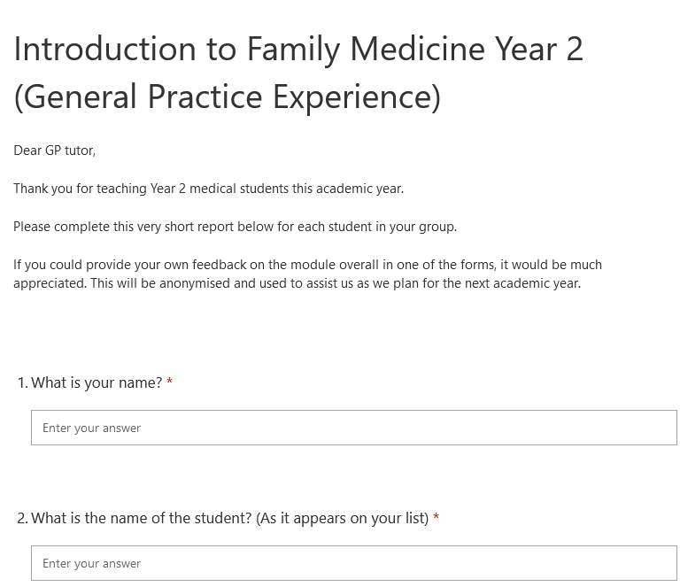
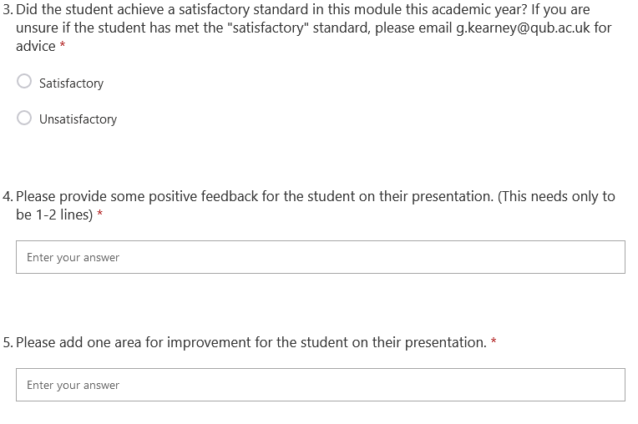
Student Assessment Sheet (Session 5)

Slide 48
Summary of what’s new Y2
Very little changed from 23/24
?other home visits
Assessment continues in Sessions 5, using
MS forms

Slide 49
Agenda
General updates
Year 1 – Family Attachment
Year 2 – General Practice Experience
Tutor group work – reflecting on learning events and tutor feedback

Slide 50
You said, we listened …
 | QUB | GP tutors
Group size in Y2 | Payment based on numbers | ?
Student ID | Provide access to MyProgress on request | ?

Slide 51
Learning events
 | QUB | GP tutors
1 Patient asked about viewing the FA report | Not the intention but ?the future | ?
2 Students went to the wrong house for HV | Specific mention in HV guidance to check at door (name/dob) | ?
3 Students had left patient details on consent form on FA report | Send report onto GP tutor only | ?
4 Students refused to sign declaration of group work | GK will emphasise (again) need to bring up issues in team early, with specific mention of groupwork | ?
5 “She presented her slides professionally“ | Use ‘the student’ in feedback | ?

Slide 52
Feedback from students
Helped me focus on patients as people

Slide 53
Peer mentoring?

